Slide 1
THE FUNDAMENTAL OF CONTROL SYSTEM
Learning objectives: At the end of this lecture participant should be able to:
Explain the meaning of control system
Describe open loop control system
Describe closed loop control system
Deduce the transfer function

Slide 2
The meaning of the control system
A system is a collection of parts or components which are set into a specified boundary. The system becomes dynamic when one or more aspect of the system change with time.
The effects which originate outside the system and act on it directly and are not changed by changes in the system are called input of the system.
Thus system inputs are independent of changes in the system state which are produced by external effects or inputs.

Slide 3
The concept of control system
The function of any control system is to automatically regulate the output and keep it at the desired value.
The desired value is the input to the system. If the input is changed, the output must respond and change to the new set value.
If something happens to disturb the output without the change of input, the output must return to the correct value

Slide 4
Parameters to be controlled
The speed or angle of a motor (electric or hydraulic)
The speed or position of a linear actuator (e.g in robotics, aircraft etc)
The temperature of an appliance e.g. oven
The pressure of a vessel e.g. a steam boiler
The quantity inside a container e.g. metering content in container
The flow rate of solids, liquids and gases e.g. controlling the steam flow to a turbine

Slide 5
Dynamic system diagram
Input output
Dynamic system

Slide 6
The Open loop system
The open loop refers to as a system with an input and output but no regulation.
An instrument system is an open loop system with an input and output but no controlling action in its operation.
The open-loop configuration does not monitor or measure the condition of its output signal as there is no feedback

Slide 7
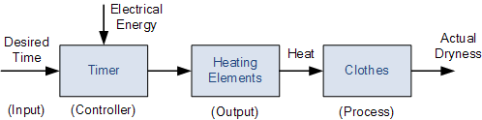
Open-loop Drying System
Drying system

Slide 8
Drying system cont
For example, an electric clothes dryer. Depending upon the amount of clothes or how wet they are, a user or operator would set a timer (controller) to say 30 minutes and at the end of the 30 minutes the drier will automatically stop and turn-off even if the clothes were still wet or damp.
In this case, the control action is the manual operator assessing the wetness of the clothes and setting the process (the drier) accordingly.

Slide 9
Drying system cont..
So in this example, the clothes dryer would be an open-loop system as it does not monitor or measure the condition of the output signal, which is the dryness of the clothes.
Then the accuracy of the drying process, or success of drying the clothes will depend on the experience of the user (operator).

Slide 10
Open loop cont…
Another example of open loop system is a dc motor whereby the speed of the motor depends on the voltage and current supplied.
The system might use a potentiometer which aid to turn an angle Ɵ_{i} (input) to produce a voltage V and this is amplified with a power amplifier producing an electric power P that drive the motor at a speed N (output)

Slide 11
Open-loop Motor Control
The speed of rotation of the motor will depend upon the voltage supplied to the amplifier (the controller) by the potentiometer.
The value of the input voltage could be proportional to the position of the potentiometer.

Slide 12
Open-loop motor control cont…
If the potentiometer is moved to the top of the resistor, the maximum positive voltage will be supplied to the amplifier representing full speed.
Likewise, if the potentiometer wiper is moved to the bottom of the resistor, zero voltage will be supplied representing a very slow speed or stop.

Slide 13
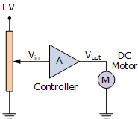
Open loop block diagram

Slide 14
The main characteristics of an
Open-loop system
There is no comparison between actual and desired values.
An open-loop system has no self-regulation or control action over the output value.
Each input setting determines a fixed operating position for the controller.
Changes or disturbances in external conditions does not result in a direct output change (unless the controller setting is altered manually).

Slide 15
Open loop block diagram
Any open-loop system can be represented as multiple cascaded blocks in series or a single block diagram with an input and output.
The block diagram of an open-loop system shows that the signal path from input to output represents a linear path with no feedback loop and for any type of control system the input is given the designation θi and the output θo.

Slide 16
Open loop cont…
Generally, we do not have to manipulate the open-loop block diagram to calculate its actual transfer function.
We can just write down the proper relationships or equations from each block diagram, and then calculate the final transfer function from these equations as shown.

Slide 17

Open-loop System
Block diagram

Slide 18

Transfer Function
The Transfer Function of each block is therefore:

Slide 19


Transfer function cont….
The overall transfer function is given as:
Then the Open-loop Gain is given simply as:

Slide 20
Transfer function cont…
When G represents the Transfer Function of the system or subsystem, it can be rewritten as: G(s) = θo(s)/θi(s)
Open-loop control systems are often used with processes that require the sequencing of events with the aid of “ON-OFF” signals.

Slide 21
Transfer function cont…
For example a washing machines which requires the water to be switched “ON” and then when full is switched “OFF”.
Also, the heater element being switched “ON” to heat the water and then at a suitable temperature is switched “OFF”, and so on.

Slide 22
Transfer function cont…
This type of “ON-OFF” open-loop control is suitable for systems where the changes in load occur slowly and the process is very slow acting, necessitating in-frequent changes to the control action by an operator.

Slide 23
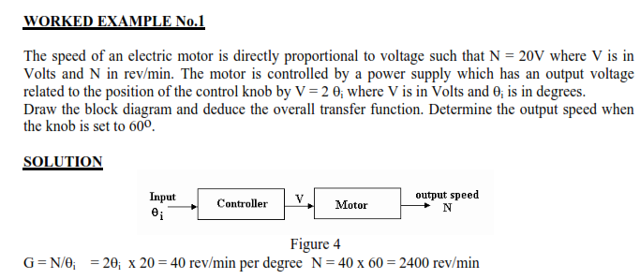
Worked example

Slide 24
Closed-loop Systems
Closed-loop Systems use feedback where a portion of the output signal is fed back to the input to reduce errors and improve stability
Systems in which the output quantity has no effect upon the input to the control process are called open-loop control systems, and that open-loop systems are just that, open ended non-feedback systems.

Slide 25
Closed system cont…
The goal of any electrical or electronic control system is to measure, monitor, and control a process and one way in which we can accurately control the process.
This is achieved by monitoring its output and “feeding” some of it back to compare the actual output with the desired output so as to reduce the error and if disturbed, bring the output of the system back to the original or desired response.

Slide 26
Closed system cont…
The quantity of the output being measured is called the “feedback signal”, and the type of control system which uses feedback signals to both control and adjust itself is called a Close-loop System.

Slide 27
Closed system cont…
A Closed-loop Control System, also known as a feedback control system is a control system which uses the concept of an open loop system as its forward path but has one or more feedback loops (hence its name) or paths between its output and its input.
The reference to “feedback”, simply means that some portion of the output is returned “back” to the input to form part of the systems excitation.

Slide 28
Closed system cont…
Closed-loop systems are designed to automatically achieve and maintain the desired output condition by comparing it with the actual condition.
It does this by generating an error signal which is the difference between the output and the reference input.
In other words, a “closed-loop system” is a fully automatic control system in which its control action being dependent on the output in some way.

Slide 29
Closed system cont…
So for example, consider our electric clothes dryer from the previous Open-loop system. Suppose we used a sensor or transducer (input device) to continually monitor the temperature or dryness of the clothes and feed a signal relating to the dryness back to the controller as shown below.

Slide 30
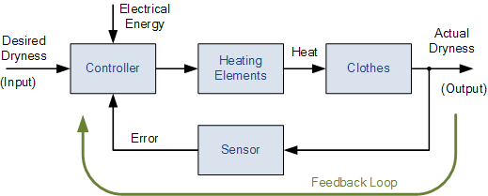
Closed-loop Control
Closed loop diagram

Slide 31
Feedback signal
This sensor would monitor the actual dryness of the clothes and compare it with (or subtract it from) the input reference.
The error signal (error = required dryness – actual dryness) is amplified by the controller, and the controller output makes the necessary correction to the heating system to reduce any error.

Slide 32
Feed back signal
Consider a dry wash machine, if the clothes are too wet the controller may increase the temperature or drying time.
Likewise, if the clothes are nearly dry it may reduce the temperature or stop the process so as not to overheat or burn the clothes, etc.
Then the closed-loop configuration is characterized by the feedback signal, derived from the sensor in the clothes drying system.
The magnitude and polarity of the resulting error signal, would be directly related to the difference between the required dryness and actual dryness of the clothes

Slide 33
Then main characteristics of Closed-loop Control
To reduce errors by automatically adjusting the systems input.
To improve stability of an unstable system.
To increase or reduce the systems sensitivity.
To enhance robustness against external disturbances to the process.
To produce a reliable and repeatable performance.

Slide 34
Closed-loop Summing Points
For a closed-loop feedback system to regulate any control signal, it must first determine the error between the actual output and the desired output.
This is achieved using a summing point, also referred to as a comparison element, between the feedback loop and the systems input.

Slide 35
Summing point…
These summing points compare a systems set point to the actual value and produce a positive or negative error signal which the controller responds too. where: Error = Set point – Actual
The symbol used to represent a summing point in closed-loop systems block-diagram is that of a circle with two crossed lines as shown.

Slide 36
Summing point…
The summing point can either add signals together in which a Plus ( + ) symbol is used showing the device to be a “summer” (used for positive feedback), or it can subtract signals from each other in which case a Minus ( − ) symbol is used showing that the device is a “comparator” (used for negative feedback) as shown.

Slide 37

Summing point
The symbol used to represent a summing point in closed-loop systems block-diagram is that of a circle with two crossed lines as shown.

Slide 38
Summing point cont..
The summing point can either add signals together in which a Plus ( + ) symbol is used showing the device to be a “summer” (used for positive feedback), or it can subtract signals from each other in which case a Minus ( − ) symbol is used showing that the device is a “comparator” (used for negative feedback).

Slide 39
Summing Point ….
Note that summing points can have more than one signal as inputs either adding or subtracting but only one output which is the algebraic sum of the inputs.
Also the arrows indicate the direction of the signals. Summing points can be cascaded together to allow for more input variables to be summed at a given point.

Slide 40

Summing point cont…

Slide 41
Closed-loop System Transfer Function
The Transfer Function of any electrical or electronic control system is the mathematical relationship between the systems input and its output, and hence describes the behaviour of the system.
Note also that the ratio of the output of a particular device to its input represents its Gain. Then we can correctly say that the output is always the transfer function of the system times the input. Consider the closed-loop system below.

Slide 42
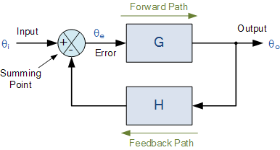
Closed-loop System Representation
Transfer function

Slide 43
Transfer Function cont…
Where: Block G represents the open-loop gains of the controller or system and is the forward path, and block H represents the gain of the sensor, transducer or measurement system in the feedback path.
To find the transfer function of the closed-loop system above, we must first calculate the output signal θo in terms of the input signal θi. To do so, we can easily write the equations of the given block-diagram as follows.

Slide 44
Transfer Function cont…
The output from the system is equal to: Output = G x Error
Note that the error signal, θe is also the input to the feed-forward block: G
The output from the summing point is equal to: Error = Input - H x Output
If H = 1 (unity feedback) then:
The output from the summing point will be: Error (θe) = Input - Output

Slide 45

Transfer Function cont…
Eliminating the error term, then:
The output is equal to: Output = G x (Input - H x Output)
Therefore: G x Input = Output + G x H x Output
Rearranging the above gives us the closed-loop transfer function of:

Slide 46

Transfer function cont…
The above equation for the transfer function of a closed-loop system shows a Plus ( + ) sign in the denominator representing negative feedback. With a positive feedback system, the denominator will have a Minus ( − ) sign and the equation becomes: 1 - GH.
We can see that when H = 1 (unity feedback) and G is very large, the transfer function approaches unity as:

Slide 47
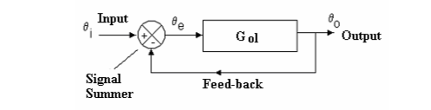
Deducing transfer function

Slide 48
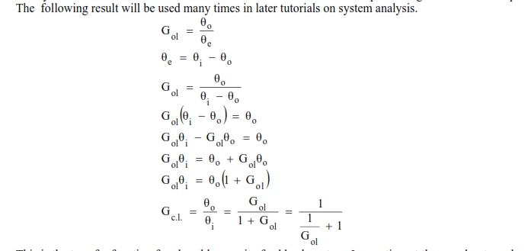
The transfer function

Slide 49
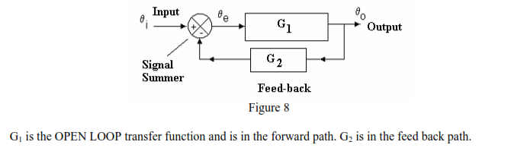
Transfer function cont……..

Slide 50
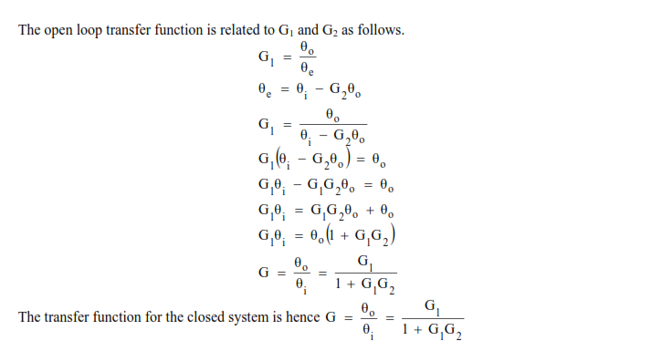
Transfer function cont………..

Slide 51
The main characteristics
To reduce errors by automatically adjusting the systems input.
To improve stability of an unstable system.
To increase or reduce the systems sensitivity.
To enhance robustness against external disturbances to the process.
To produce a reliable and repeatable performance.

Slide 52
Important of feedback in control system
Feedback is used in closed-loop control system to provide the signal for reducing error between the referenced input and the system output. However, feedback has a significant effect on system stability, sensitivity etc.

Slide 53
Open and closed loop control system
Open loop system

